Slide 1
Levels of Management

Slide 2
Levels of Management
The term Levels of Management refers to a line of demarcation between various managerial positions in an organization. The number of levels in management increases when the size of the business and work force increases and vice versa. The level of management determines a chain of command, the amount of authority & status enjoyed by any managerial position. The levels of management can be classified in three broad categories:
Top level / Administrative level
Middle level / Executory
Low level / Supervisory / Operative / First-line managers

Slide 3
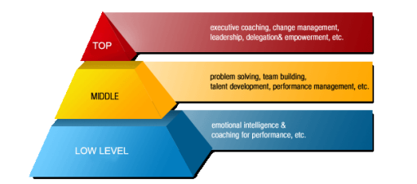

Slide 4
Top Level of Management
It consists of board of directors, chief executive or managing director. The top management is the ultimate source of authority and it manages goals and policies for an enterprise. It devotes more time on planning and coordinating functions. The role of the top management can be summarized as follows –
Top management lays down the objectives and broad policies of the enterprise.
It issues necessary instructions for preparation of department budgets, procedures, schedules etc.
It prepares strategic plans & policies for the enterprise.
It appoints the executive for middle level i.e. departmental managers.
It controls & coordinates the activities of all the departments.
It is also responsible for maintaining a contact with the outside world.
It provides guidance and direction.
The top management is also responsible towards the shareholders for the performance of the enterprise.

Slide 5
Middle Level of Management
The branch managers and departmental managers constitute middle level. They are responsible to the top management for the functioning of their department. They devote more time to organizational and directional functions. In small organization, there is only one layer of middle level of management but in big enterprises, there may be senior and junior middle level management. Their role can be emphasized as –
They execute the plans of the organization in accordance with the policies and directives of the top management.
They make plans for the sub-units of the organization.
They participate in employment & training of lower level management.
They interpret and explain policies from top level management to lower level.
They are responsible for coordinating the activities within the division or department.
It also sends important reports and other important data to top level management.
They evaluate performance of junior managers.
They are also responsible for inspiring lower level managers towards better performance.

Slide 6
Lower Level of Management
Lower level is also known as supervisory / operative level of management. It consists of supervisors, foreman, section officers, superintendent etc. According to R.C. Davis, “Supervisory management refers to those executives whose work has to be largely with personal oversight and direction of operative employees”. In other words, they are concerned with direction and controlling function of management. Their activities include –
Assigning of jobs and tasks to various workers.
They guide and instruct workers for day to day activities.
They are responsible for the quality as well as quantity of production.
They are also entrusted with the responsibility of maintaining good relation in the organization.
They communicate workers problems, suggestions, and recommendatory appeals etc to the higher level and higher level goals and objectives to the workers.
They help to solve the grievances of the workers.

Slide 7
Lower Level of Management
They supervise & guide the sub-ordinates.
They are responsible for providing training to the workers.
They arrange necessary materials, machines, tools etc for getting the things done.
They prepare periodical reports about the performance of the workers.
They ensure discipline in the enterprise.
They motivate workers.
They are the image builders of the enterprise because they are in direct contact with the workers.

